Slide 1
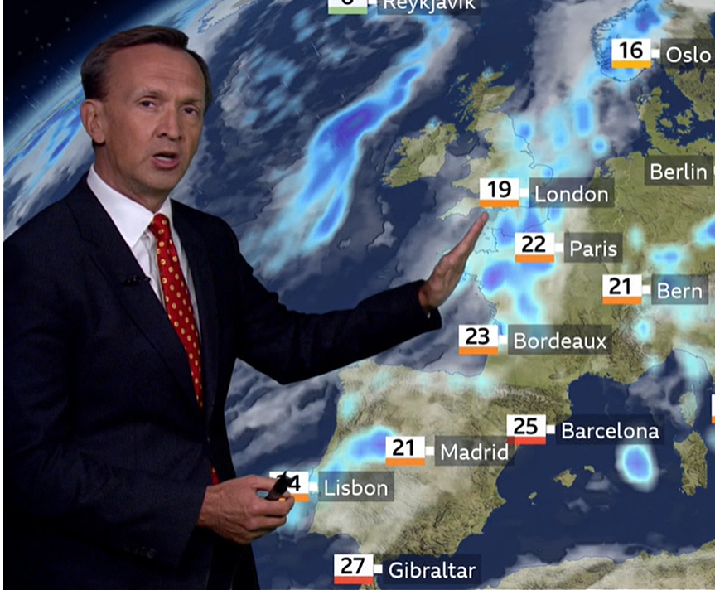

Capstone Project
Weather Analysis
Notes:
Hi everyone,
My name is Shiraj Ahmad,
and I'm a mentor here for data science.
In this session, I'll be explaining Power BI's Capstone Project: Weather Analysis
First, congratulations on completing Excel, SQL, and Power BI.
After completing this Capstone Project, you'll be job-ready!
So, let's get started.

Slide 2
Overview
Humidity Analysis
Pressure Analysis
Temperature Analysis
Weather Description Analysis
Wind Direction Analysis
Wind Speed Analysis
The dataset contains 5 years of high temporal resolution (hourly measurements) data of various weather attributes,
such as temperature, humidity, air pressure, etc.
This data is available for 30 US and Canadian Cities, as well as 6 Israeli cities.
Notes:
Lets have a overview of the project
The dataset contains ~5 years of high temporal resolution data of various weather attributes, such as temperature, humidity, air pressure, etc.
Weather data is both intrinsically interesting, and also potentially useful when correlated with other types of data. For example,
Wildfire spread is potentially related to weather conditions,
demand for cabs is famously known to be correlated with weather conditions Traffic is also probably related to weather. Another potentially interesting source of correlation is between weather and crime.
There are many other potentially interesting connections between everyday life and the weather that we can explore together with the help of this dataset.
Weather plays a pivotal role in our daily lives, influencing a wide range of activities from agriculture and transportation to lifestyle choices.
The Comprehensive Weather Analysis Capstone Project is designed to delve into various meteorological factors, providing valuable insights and facilitating informed decision-making.
The project encompasses a thorough examination of six key aspects of weather data:
**1. Humidity Analysis**
To understand the patterns and variations in humidity levels in a specific geographic area.
Humidity affects human comfort, health, and can impact various industries such as agriculture, HVAC systems, and tourism.
**2. Pressure Analysis**
To analyze atmospheric pressure data to identify trends, variations, and anomalies.
Atmospheric pressure is crucial for weather forecasting and understanding meteorological phenomena like storms.
**3. Temperature Analysis**
**Objective**: To study temperature trends, seasonal changes, and variations in temperature data.
**Importance**: Temperature analysis is vital for various sectors, including agriculture, energy management, and urban planning.
**4. Weather Description Analysis**
**Objective**: To categorize and analyze weather descriptions to understand weather conditions.
**Importance**: Weather descriptions provide essential information for daily planning, aviation, and emergency management.
**5. Wind Direction Analysis**
**Objective**: To assess wind direction patterns and their impact on local weather conditions.
**Importance**: Wind direction influences weather patterns, air quality, and renewable energy sources like wind turbines.
**6. Wind Speed Analysis**
**Objective**: To examine wind speed data for insights into wind patterns and intensity.
**Importance**: Wind speed analysis is critical for activities such as sailing, wind energy generation, and disaster preparedness.
**Methodology**
The project will employ data analysis techniques, statistical methods, and data visualization tools to extract meaningful insights from the provided weather dataset. Each aspect of weather analysis will be approached systematically, with a focus on identifying trends, correlations, and outliers.
**Expected Outcomes**
By the project's conclusion, we aim to provide a comprehensive understanding of weather conditions in the selected geographic area. This knowledge can be leveraged by various stakeholders, including government agencies, businesses, and individuals, to make informed decisions related to agriculture, energy management, travel, and more.
**Significance**
The Comprehensive Weather Analysis Capstone Project is significant because it equips us with the tools and knowledge to harness weather data for practical purposes. Weather affects our lives in numerous ways, and a detailed analysis can lead to better planning, improved resource management, and enhanced safety measures.
**Conclusion**
Weather analysis is a multifaceted endeavor, and this Capstone Project seeks to explore various dimensions of weather data. By comprehensively studying humidity, pressure, temperature, weather descriptions, wind direction, and wind speed, we aim to contribute to a deeper understanding of the dynamic and ever-changing world of meteorology. This knowledge can empower individuals and organizations to adapt to weather conditions effectively and make informed decisions for a more sustainable future.

Slide 3

Problem Statement
Objective
Analysis Scope
Goal
Insights & Recommendations.
Report & Presentation
Notes:
problem statement for your Weather Analysis Capstone Project,
**Problem Statement**
**Objective**:
The primary objective of the Comprehensive Weather Analysis Capstone Project is to gain in-depth insights into various meteorological factors affecting a specific geographic area. This analysis aims to provide valuable information to a wide range of stakeholders, including government agencies, businesses, and individuals, to support informed decision-making.
**Analysis Scope**:
The analysis will encompass six key aspects of weather data: humidity, pressure, temperature, weather descriptions, wind direction, and wind speed. It will focus on historical data spanning a significant timeframe to identify trends, variations, and anomalies in each of these meteorological variables.
**Goal**:
The overarching goal of this project is to extract meaningful insights from the provided weather dataset. These insights will contribute to a comprehensive understanding of local weather conditions, enabling stakeholders to make informed decisions related to agriculture, energy management, transportation, urban planning, and emergency preparedness. Specific goals include:
- Identify long-term trends and seasonal variations in temperature and humidity data.
- Analyze atmospheric pressure patterns to aid in weather forecasting.
- Categorize and analyze weather descriptions to understand weather conditions.
- Assess wind direction and speed patterns to support industries like renewable energy and aviation.
**Insights & Recommendations**:
The project aims to provide actionable insights based on the analysis of weather data. These insights will serve as a foundation for informed decision-making. Recommendations will be tailored to various stakeholders, such as:
- Government agencies: Recommendations for disaster preparedness, urban planning, and climate change mitigation.
- Agricultural sector: Insights for optimizing planting and harvesting schedules.
- Energy sector: Recommendations for wind energy generation based on wind speed and direction analysis.
- General public: Weather forecasts and safety recommendations.
**Report & Presentation**:
The findings and recommendations will be documented in a comprehensive report and presented through data visualizations, charts, and graphs. The report will include detailed explanations of the analysis methodology, key insights, and actionable recommendations for each aspect of weather analysis. The presentation will highlight significant trends and findings, making it accessible to a broad audience.
Overall, this Capstone Project seeks to harness the power of weather data to improve decision-making across various sectors, ultimately contributing to more efficient and sustainable practices in response to changing weather conditions.

Slide 4


Significance
Valuable insights
Improvement focus
Evaluation of effectiveness
Trend identification
Comprehensive understanding
Notes:
significance of your Capstone Project, covering the five aspects you mentioned:
**Significance of the Capstone Project**
This Comprehensive Weather Analysis Capstone Project holds significant importance due to its potential to provide:
1. **Valuable Insights**: The project's analysis of various meteorological factors, including humidity, pressure, temperature, weather descriptions, wind direction, and wind speed, offers valuable insights into local weather patterns. These insights can help individuals and organizations make informed decisions related to daily activities, agriculture, travel, and more.
2. **Improvement Focus**: By examining weather data comprehensively, the project allows for the identification of areas that may require improvement or adaptation. For instance, understanding temperature trends can aid in optimizing energy management systems, and analyzing wind patterns can help enhance the efficiency of renewable energy sources like wind turbines.
3. **Evaluation of Effectiveness**: Weather analysis is integral to the effectiveness of various sectors, such as agriculture, transportation, and urban planning. The project's findings can contribute to evaluating the effectiveness of existing strategies and informing the development of new ones to better cope with changing weather conditions.
4. **Trend Identification**: The project's systematic analysis of weather data enables the identification of long-term trends, seasonal variations, and unexpected anomalies. Recognizing these trends is vital for planning and preparedness, whether for businesses adapting to changing climates or individuals making weather-dependent decisions.
5. **Comprehensive Understanding**: By addressing multiple aspects of weather analysis, this project provides a holistic and comprehensive understanding of the selected geographic area's weather conditions. This knowledge empowers stakeholders to consider multiple factors simultaneously and make well-rounded decisions based on a comprehensive view of meteorological data.
In conclusion, this Comprehensive Weather Analysis Capstone Project offers a unique opportunity to gain valuable insights, focus on areas for improvement, evaluate the effectiveness of strategies, identify trends, and achieve a comprehensive understanding of the dynamic world of meteorology. Its significance lies in its potential to inform decision-making, enhance preparedness, and contribute to a more sustainable and resilient future in the face of ever-changing weather patterns.

Slide 5
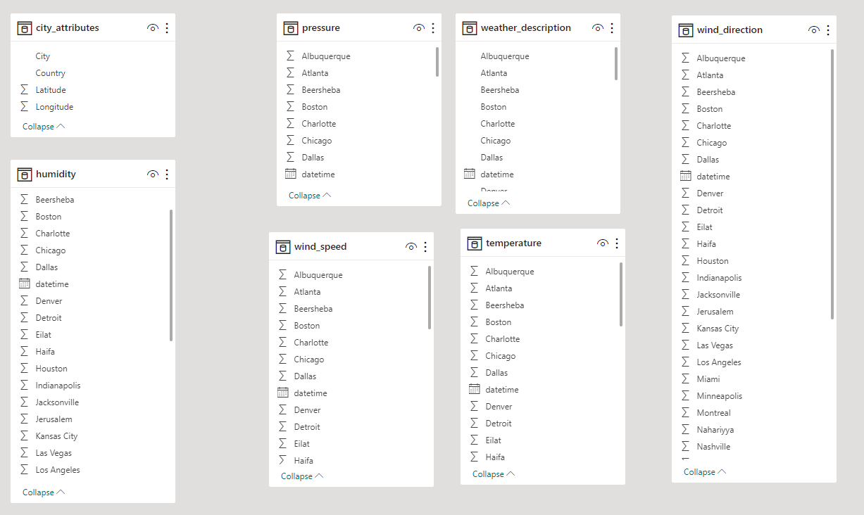
Tables
Notes:
Now that we have comprehended the problem statement and recognized the significance of the project, let's delve into a thorough understanding of the dataset.
We have seven tables in the dataset where we have different weather attributes. You have to transform these tables in a form where you can create a relationship between these tables. Try to understand the current structure of the table and convert it in a form which will help analyse, solve Problem statements.
I trust that you now have a clear understanding of the Capstone project requirements.

